Slide 1
Asia-Pacific Space Cooperation Organization
Call for Participation
APSCO Cubesat Competition (ACC)
ACC is now open for participation. Student Teams from APSCO Member States are welcome to join.

Slide 2
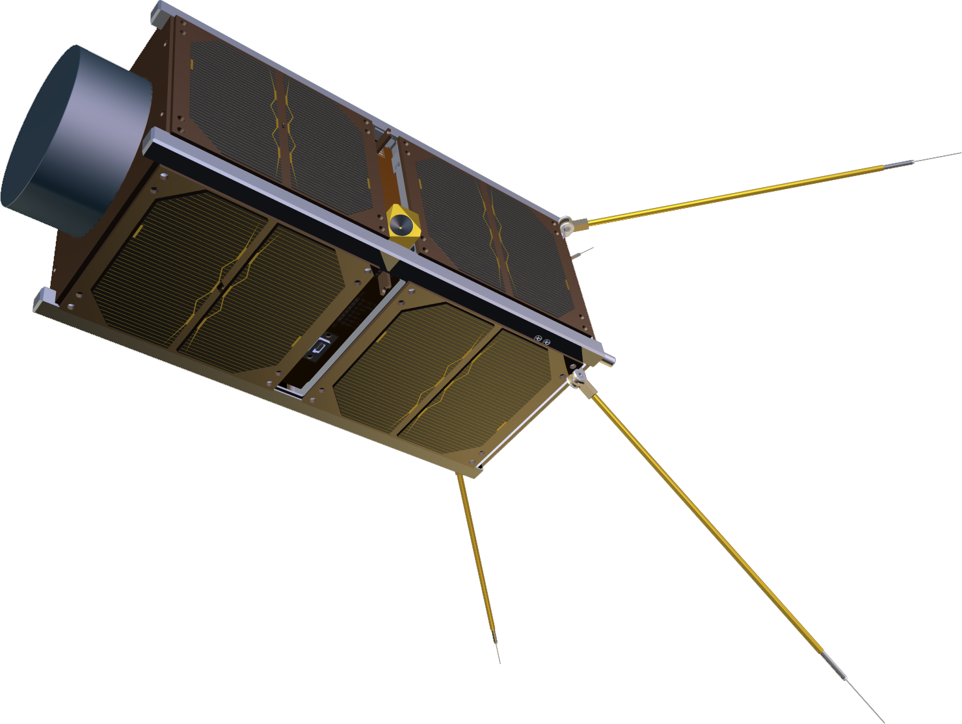
What is ACC?
ACC, which stands for “APSCO Cubesat Competition”, is a project initiated by APSCO and comprises a comprehensive training and educational program for APSCO Member States’ students. Participants in ACC, will undergo a multi-featured program which includes Training, Designing, Building and Testing an engineering model of a Cubesat. The model should include 3-Units either in an integrated form (a 3U-Cubesat) or a combination of 1/2 Unit(s) Cubesats (three 1U or one 2U plus one 1U cubesats)
ACC provides equal opportunity for University students from all APSCO Member States. Every member state is entitled to introduce three teams to enter the educational and design phases of ACC. One student team from each Member State, will have the opportunity to enter the engineering model development phase.

Slide 3
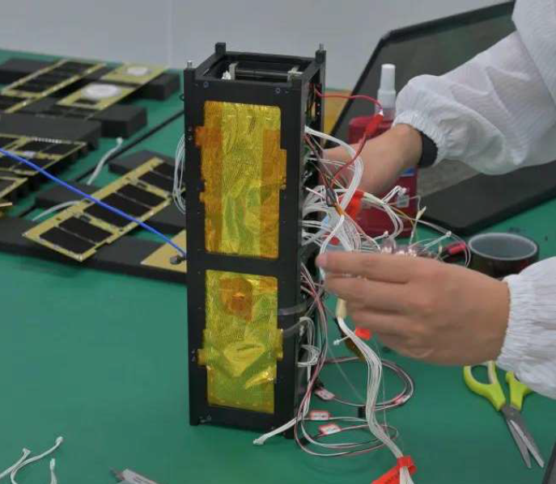
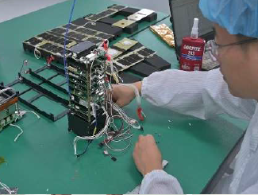
What is ACC?
ACC focuses on mentoring the participants throughout the lifecycle of a space mission, from theory to practice and evolves academic knowledge into practical experience. It is essential for participants to follow all the phases continuously, from conceptual design to model assembly and integration.
If the detailed design of the teams are approved by the management board of ACC , they will proceed to the final phase to build the engineering model. The Engineering Models will be tested at the Final Competition Convention. Teams which manage to present satisfactory performance in the tests, will receive full financial support.

Slide 4
How to enroll?
Willing teams should follow these steps to participate:
1- Team formation and initial team introduction.
Following receiving the “Call for Registration” (this document), every APSCO Member State are entitled to form 1 to 3 teams and introduce team members to APSCO.
All members of each team, except for the supervisor or team head, should be student at the time of the competition kick off (“Teams Introduction and Mission Assessment Meeting”).
Number of team members is not limited. However, only 5 members from each team can attend in-person activities with financial sponsorship.
It is recommended to include one PhD student in every team. It is also recommended to include Aerospace, Mechanical, Electrical and Computer Science BSc and MSc students in the teams.
2- Mission definition
3- Proposal preparation and submission to APSCO
4- Attendance at “Teams Introduction and Mission Assessment Meeting”

Slide 5
How to enroll?
Willing teams should follow these steps to participate:
1- Team formation
Following the formation of the teams and initial team introduction, every team should define a space mission.
The mission should be viable within budget limitations of a 3-Units model (a 3U-Cubesat) or a combination of 1/2 Unit(s) Cubesats regarding mass, volume and expected performance.
Building the Engineering model to perform the proposed mission should be affordable within the allocated budget (100k$) .
All types of missions, including commercial, scientific, experimental, etc. can be proposed. However, the proposed mission should be technologically practical.
2- Mission definition
3- Proposal preparation and submission to APSCO
4- Attendance at “Teams Introduction and Mission Assessment Meeting”

Slide 6
How to enroll?
Willing teams should follow these steps to participate:
1- Team formation
The mission proposal should be prepared in the template provided by ACC management. The template will be made available by APSCO in due time.
It is essential to provide the requested items in all the fields of the template.
The mission proposal should be submitted before the deadline.
The proposal should be presented in the “Teams Introduction and Mission Assessment Meeting”.
2- Mission definition
3- Proposal preparation and submission to APSCO
4- Attendance at “Teams Introduction and Mission Assessment Meeting”

Slide 7
How to enroll?
Willing teams should follow these steps to participate:
1- Team formation
“Teams Introduction and Mission Assessment Meeting” will be held in summer 2023.
The meeting will be held online.
Each team will present its members and mission in the meeting
The Proposal will either be accepted, conditionally accepted (requiring some modifications) or rejected.
Teams with accepted proposals will enroll at ACC and enter phase A.
2- Mission definition
3- Proposal preparation and submission to APSCO
4- Attendance at “Teams Introduction and Mission Assessment Meeting”

Slide 8
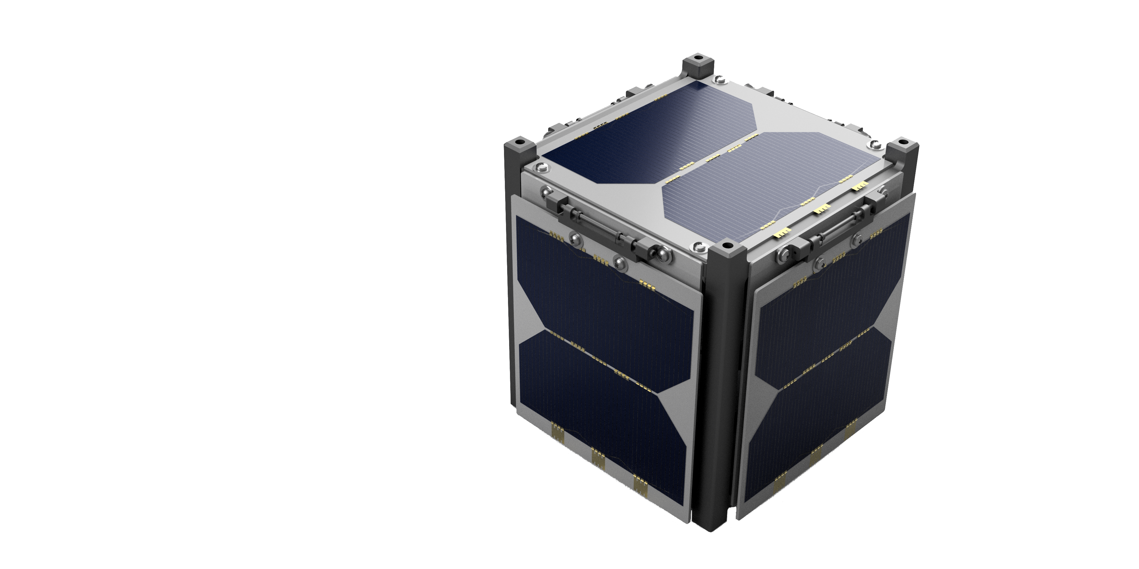
Important dates
May 2023
Call for participation
Jun 2023
Initial team introduction
July 2023
1st training course
(Conceptual design training)
Aug 2023
Submission of Mission Proposal
Sep 2023
Teams Introduction and Mission Assessment
Meeting (Online)

Slide 9
ACC phases
Phase-Zero:
Preparation and team formation
Member states are informed of the competition and introduce their teams.
Phase-A:
Design
Online training course 2 and 3 are held.
Summer camp including hands-on training is held.
Phase-B:
EM development
Engineering models are developed and tested
One team from every member state proceed to detailed design.
Final competition convention is held
The cost of hardware is paid to participating teams.
Team Introduction and Project Proposal Review meeting is held
Introduced teams from Member State with verified mission enter this phase.
Participating teams design their Cubesat.
Online training course 1 is held

Slide 10
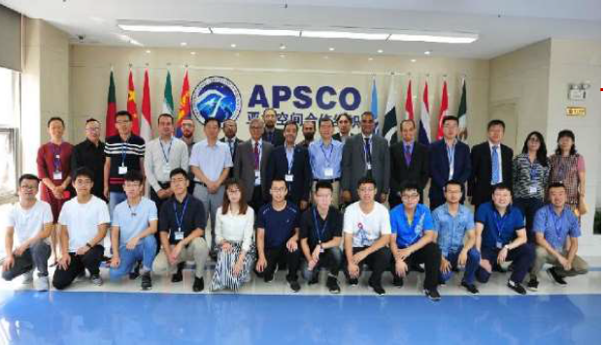
Training program
Training One
(Phase zero - Online)
Conceptual Design
Training Two
(Phase A - Online)
Preliminary Design
Training Three
(Phase A - Online)
Detailed Design
Summer Camp
(Phase A - In-person)
EM Integration
The training program of ACC includes three series of online educational courses and one hands‐on training for the participants. All the trainings will be held during phase zero and A.
The syllabus of the each training program corresponds with the sequence of the design and development process.
The hands‐on training will be in‐person and held in the summer camp.

Slide 11
Key information and rules
1. All members of each team, except for the supervisor or team head, should be student at the time of the competition kick off (“Teams Introduction and Mission Assessment Meeting”).
2. Teams may acquire consultancy from industrial entities. But the role and domain of the activity of the consultants should remain at the consultancy level.
3. ECSS standard will be the baseline for satellite design, building and testing throughout the course of ACC project. However, the Cubesat Development Manual (CDM) will be the main reference in this regard.
4. Timely delivery of the deliverables (reports and EM) by participating teams will be considered as one of the assessment measures of teams performance. Late presentation of the deliverables will disqualify teams from proceeding to the following phase and receiving the due payment.

Slide 12
To introduce the teams, please contact the APSCO focal point in your country

